Slide 1
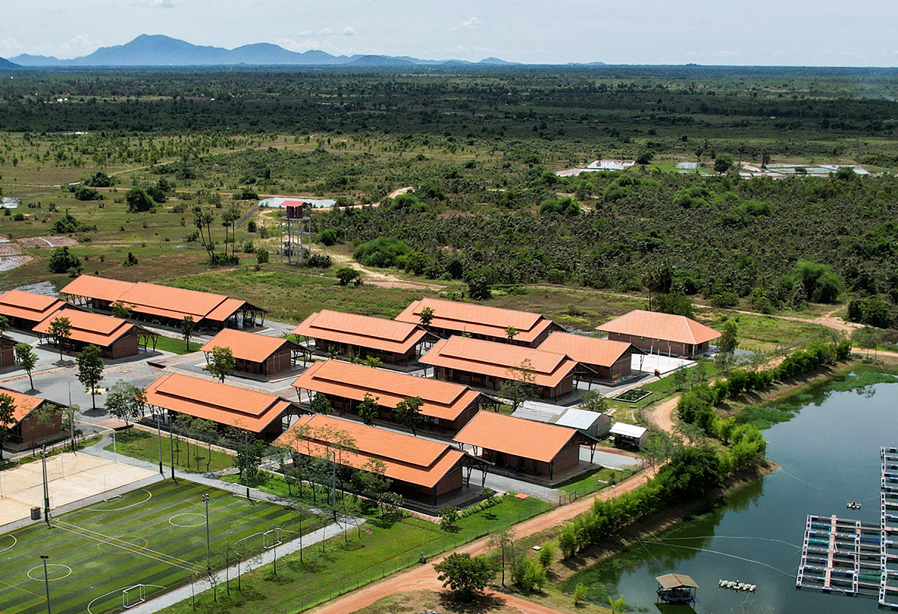





Driving Change Together
Genus is an ideal Corporate Fundraising Partner for Smiling Gecko, thanks to its extensive experience in local community-focused initiatives with a connection to food security and agriculture
Benefits for Genus
Alignment with key CSRD reporting metrics
Enhanced and elevated CSR campaigns
Tailored service offerings
Creation of social and sustainable impact
Smiling Gecko CSR
Initiative
2024

Slide 2
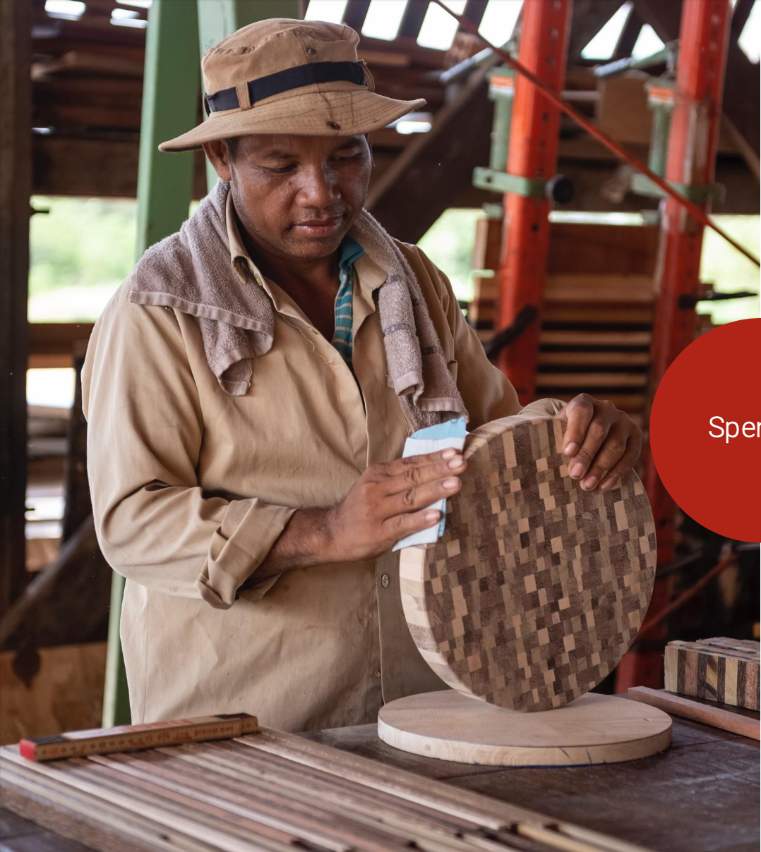





Enhance quality of life in rural Cambodia
Developing sustainable social enterprises
Delivering education and vocational training
Strengthening food security - organic farming, fish production, school meals
Fostering resilience and nationwide impact - cultural initiatives like "The Gong”
Purpose &
Vision

Slide 3
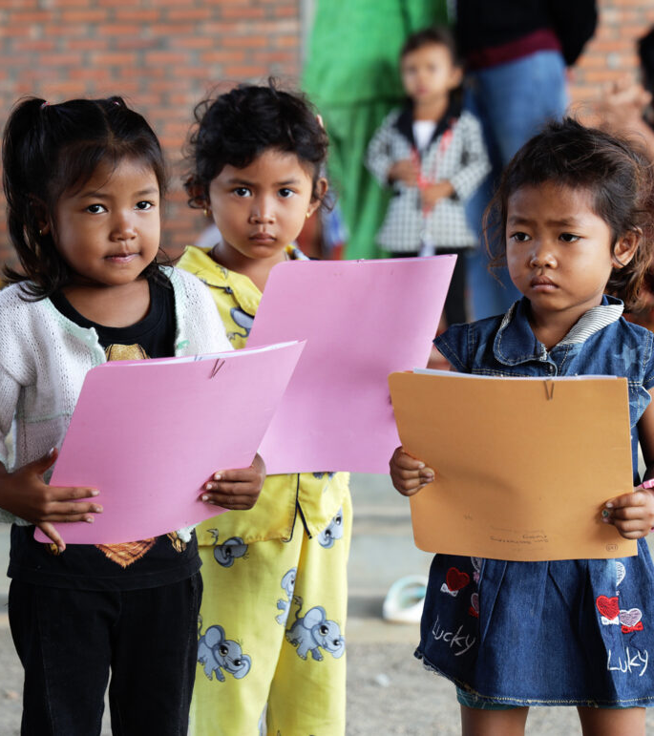

Economic
High poverty rates, with over one-third of Cambodians living on less than $2/day
Social
29% of 15-24-year-olds have not completed primary education in Cambodia
500’000 children in Cambodia grow up without their parents
The
Problem
Environmental
Unsustainable agricultural practices and biodiversity loss

Slide 4
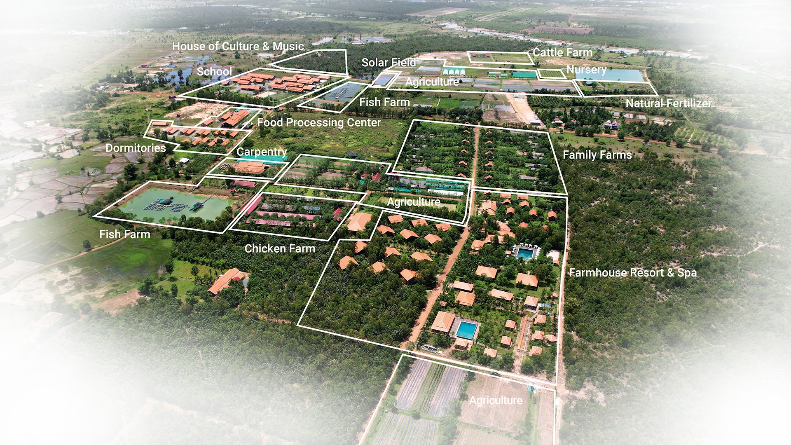




Smiling
Gecko
Campus
Craftsmanship & Production
Food Security & Sustainable Agriculture
Educational Development
Emergency Relief & Basic Needs
Community Development & Employment

Slide 5
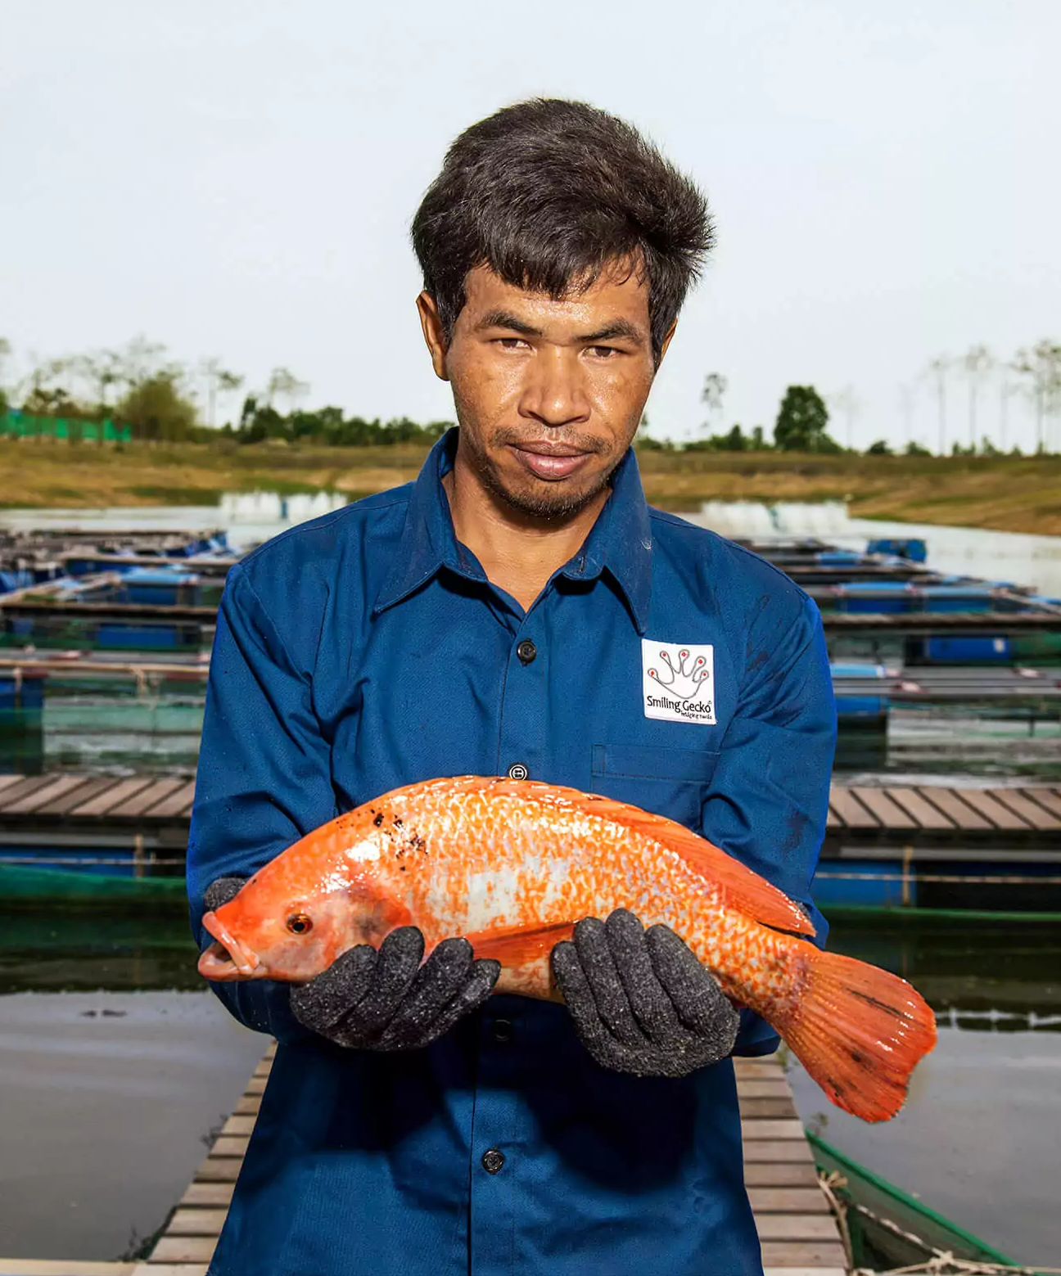



Local Fish Farm Project
Since 2018, SG has been producing Tilapia. In order to be able to sell 22t of fish, we need to further develop our infrastructure and strengthen the skills required for commercial scale farming
Food Security & Sustainable Agriculture
The Problem it resolves
Your
Impact
Fish is particularly important as a food source because it is affordable and a source of protein | The farm can improving both food security and farmer incomes
Funding need
20’000 $ commitment each year

Slide 6

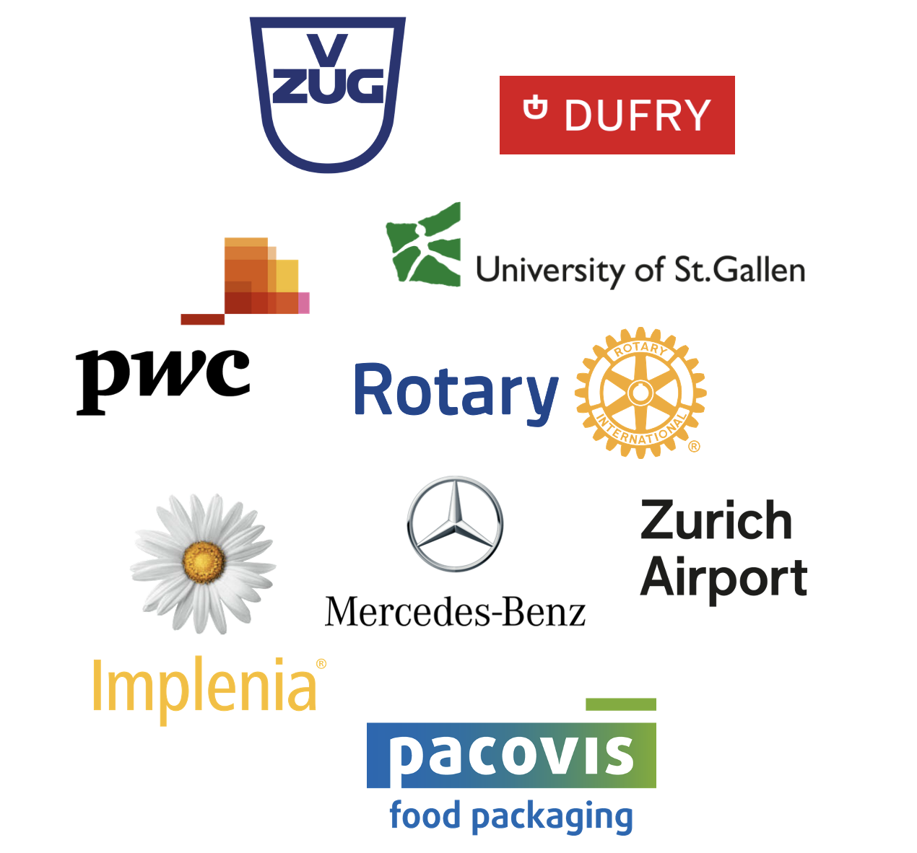
Organizations in Switzerland that have already successfully integrated Smiling Gecko into their CSR framework

Slide 7

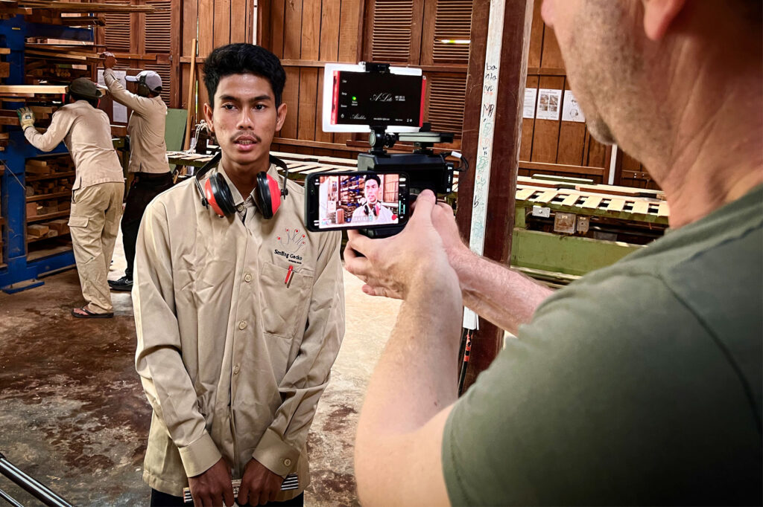
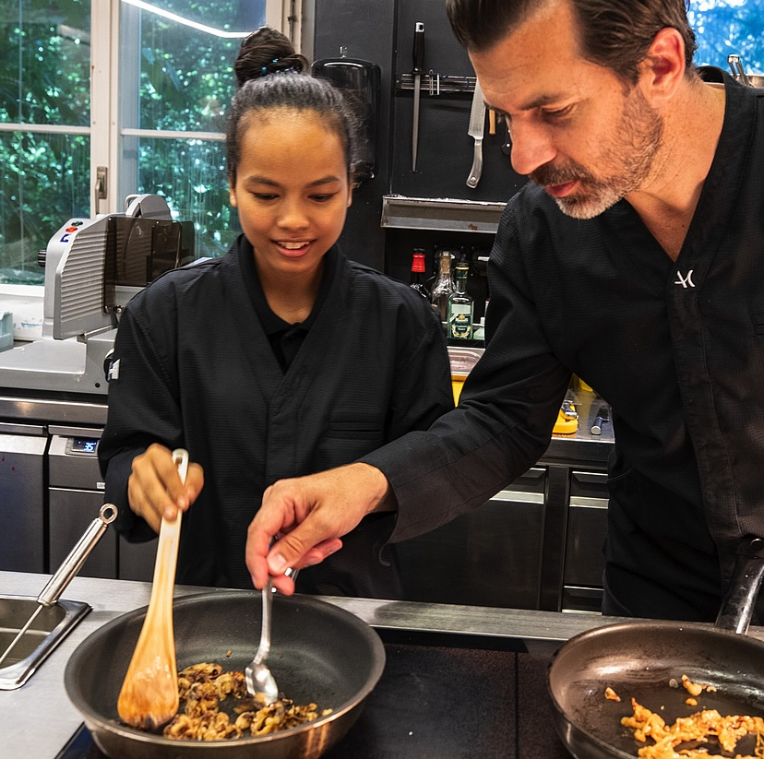
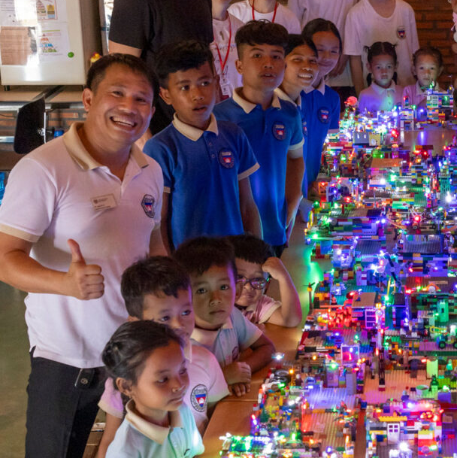

 | Monthly updated marketing material produced by an on-site video team in Cambodia
 | Interactive workshops (online and in UK), highlighting Smiling Gecko’s work and impact
 | Regular reporting with KPIs and progress updates (SDGs, CSRD reporting)
 | Visits to Smiling Gecko Campus, with full access to the resort’s amenities
If you want to help us,
We will help you

Slide 8
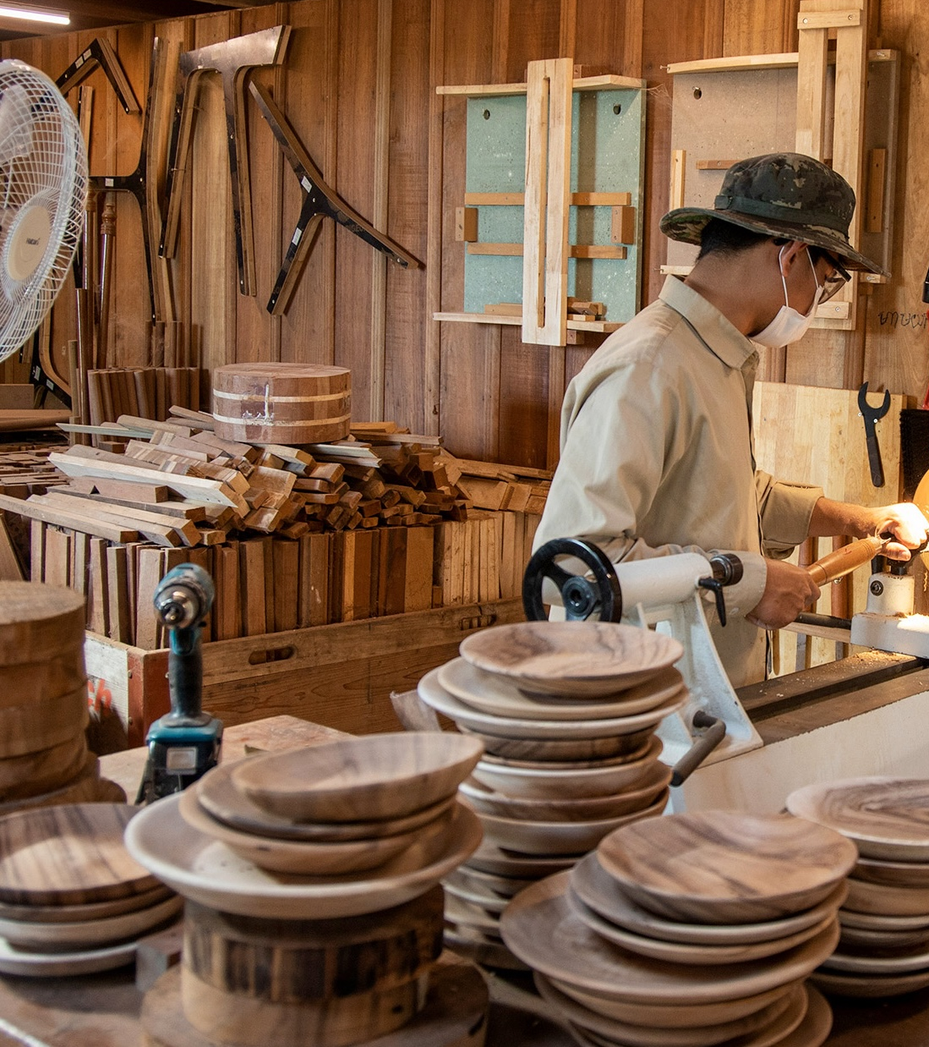

Self-Sufficieny
The aim is to create a circular economy that generates revenue for the entire community while:
Providing equal opportunities to bridge the inequality gap
Empowering communities through sustainable social enterprises
Attracting external investments to scale and replicate the model nationally
Smiling
Gecko
Model
1
NGO
2
Social Enterprise
3
Self-Sufficient Community

Slide 9
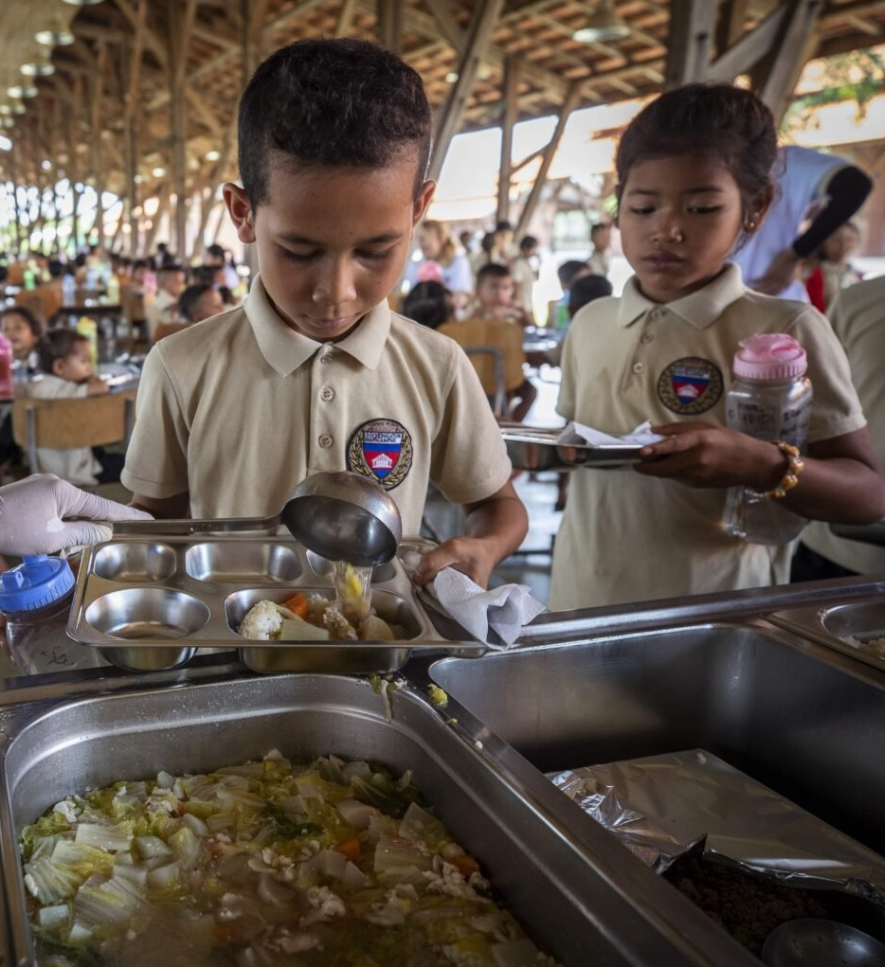

Building a Future for
Cambodia
520
children are going to school at the Smiling Gecko campus
50
more students every year are planned, ensuring continuous growth and opportunities
Innovative initiatives like the Farmhouse have already achieved self-sufficiency, paving the way for sustainable progress and empowerment
Evidence of
Success

Slide 10
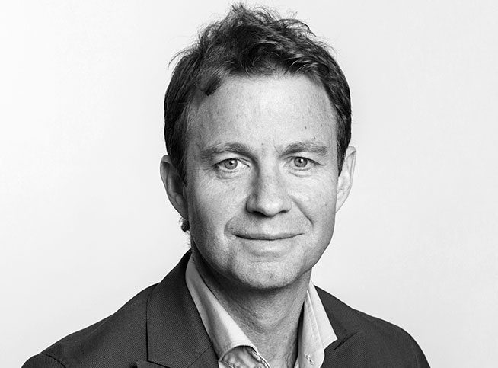
Your Contact at Smiling Gecko
Alain Biner
Telefon: +41 44 321 67 70
E-Mail: biner@smilinggecko.ch

